Slide 1

Border Crossing Analysis by Mode of Transport
A Comparative Look at Canadian and Mexican Borders
Notes:
Welcome, everyone. Today, we'll explore the traffic patterns at U.S. borders with Canada and Mexico, focusing on the movement of people and goods across these key crossings. We'll examine trends by transport mode and use machine learning to predict future traffic patterns. Let’s dive into the insights!

Slide 2
Purpose of the Analysis
To analyze the volume of border crossings at U.S. borders with Canada and Mexico based on different modes of transport.
To highlight key trends and compare traffic patterns between the two borders.
To predict whether border crossings will increase or decrease using various machine learning methods. Random forest seemed to be the most accurate.
Notes:
Our goal is to understand the flow of people and goods across the Canadian and Mexican borders and predict future trends. We used various machine learning models, including Random Forest, which provided the most accurate results in forecasting changes in crossing volumes.

Slide 3
Data Overview
Data Sources: U.S. Customs and Border Protection
Time Period: 1996 – 2024
Key Variables:
Border: Canadian or Mexican.
Mode of Transport: Personal vehicles, pedestrians, trucks, trains, etc.
Count: Total crossings.
Notes:
Welcome, everyone. Today, we'll explore the traffic patterns at U.S. borders with Canada and Mexico, focusing on the movement of people and goods across these key crossings. We'll examine trends by transport mode and use machine learning to predict future traffic patterns. Let’s dive into the insights!

Slide 4
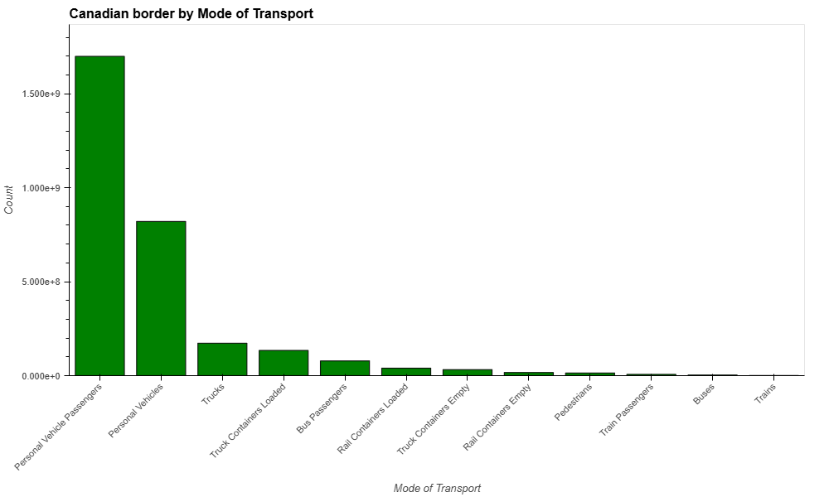
Canadian Border Crossings by Mode of Transport
Key Observations:
Personal Vehicle Passengers dominate with over 1.5 billion crossings indicating most vehicles carry multiple passengers.
Total freight-related crossings: 240 million crossings.
Notes:
At the Canadian border, personal vehicle passengers account for the majority of crossings, with over 1.5 billion recorded during the time span. Freight-related crossings total approximately 240 million, primarily driven by truck and rail freight activity.

Slide 5
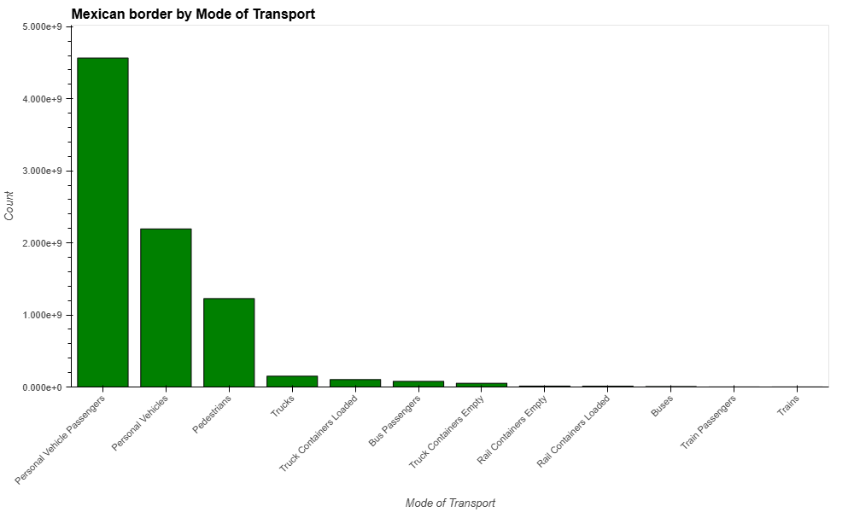
Mexican Border Crossings by Mode of Transport
Personal Vehicle Passengers dominate with over 4 billion crossings indicating most vehicles carry multiple passengers.
Total freight-related crossings: 190 million crossings
Notes:
In contrast, at the Mexican border, personal vehicle passengers also dominate crossings, with over 4 billion recorded. However, freight-related crossings total approximately 190 million, compared to Canada's 240 million, with truck crossings being the largest contributor.

Slide 6


Map of U.S. Border Crossings
U.S top 5 Busiests and Least Used Ports of Entry
Notes:
This OpenStreetMap highlights the busiest and least used ports of entry. The busiest, such as El Paso, TX, and San Ysidro, CA, reflect key trade and travel hubs. In contrast, the least used, like Boquillas, TX, with only 56 crossings recorded during the time span, are located in more remote areas, illustrating the variability in crossing volumes across the country.

Slide 7

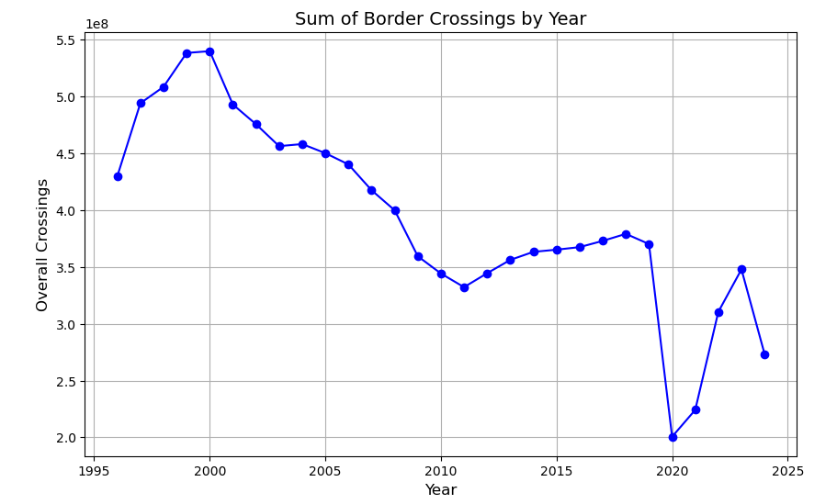



Initial Analysis
Initially reviewed the dataset using python/pandas. Looked over summaries of overall crossings by year, state, etc. Used matplotlib to summarize overall crossings by year included in dataset.
Data shows that border crossings have been at a decrease over time but has fluctuated.

Slide 8
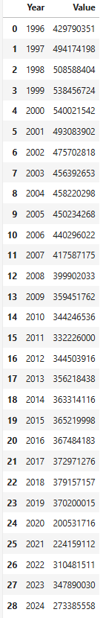
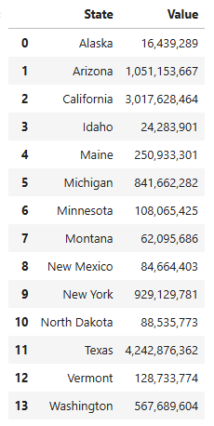
Initial Analysis
Overall, the dataset shows that Texas had the most crossings between 1997-2024.
Crossings were at an all time high in 2000 with the total recorded number being 540,021,542.

Slide 9
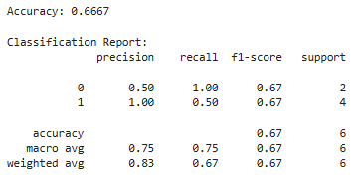
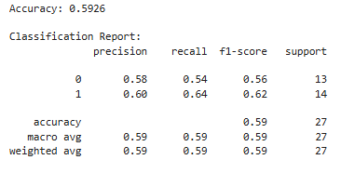
Future Predictions
Linear Regression:
Wanted to predict whether overall crossings will increase or decrease throughout the future.
Tested a few machine learning methods to predict an increase/decrease for future years. Used, summarized data by year/state and overall crossings. Then added column with % increase/decrease from year to year, and additional with increase/decrease result. Used linear Regression to predict from a sample. Accuracy was only 67%.
Tried to switch to Logistic Regression using the same data frame, but accuracy decreased.
Logistic Regression:

Slide 10
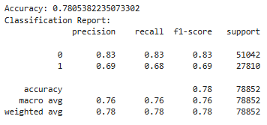
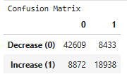
Future Predictions
Random Forest:
Decided to increase the size of the sample dataset instead of using summarized data frame, and switch machine learning model using Random Forest.
Used label encoder to update data to numeric so all columns can be included in the model.
Used similar python/pandas code from previous attempts to add columns with % increase, and general result increase/decrease.
Updates to model returned 78% accuracy
Confusion Matrix:
The model correctly predicted future decreases in 42,609 cases and was incorrect in 8,433 cases. For increases, the model predicted correctly in 18,938 cases and was incorrect on 8,872 cases.

Slide 11
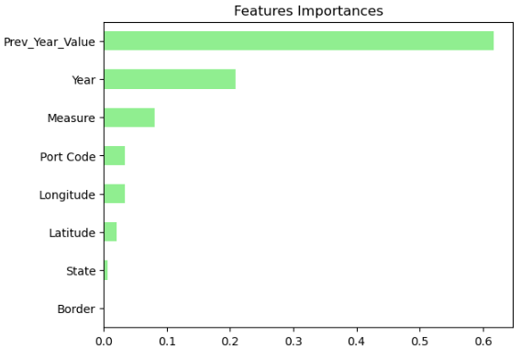
Random Forest
Concluded that the Random Forest was the most accurate method used when testing the data.
Reviewing the confusion matrix, the model predicted more decreases than increases in the future. Although crossings will fluctuate, we can conclude that as we move forward, the number of border crossings recorded will decrease.
Above are the features included in the model sorted by the importance that each served in the results.

Slide 12
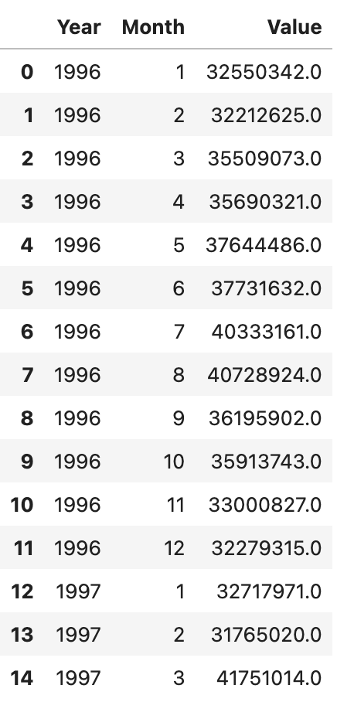
Process
We started the process by isolating the features that we wanted to use.
We separated the year and month as they were combined in our original dataset.
We used the month to capture seasonality and the year for a broad analysis of our dataset.
We also added the total measure of the crossings for each month starting in the year the dataset was created.

Slide 13
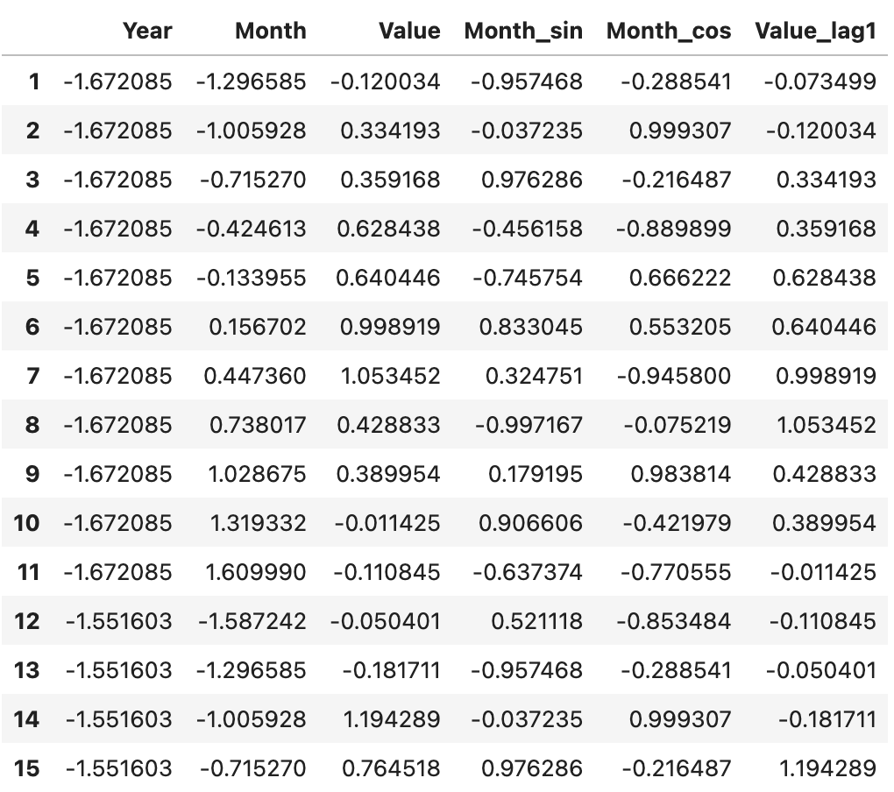
From the table, we scaled the data for each column. Then we added cyclical features so that the models can better understand by representing months on a circular scale as points on a circular unit. We then added lag features of previous months so that the models have points of reference.

Slide 14
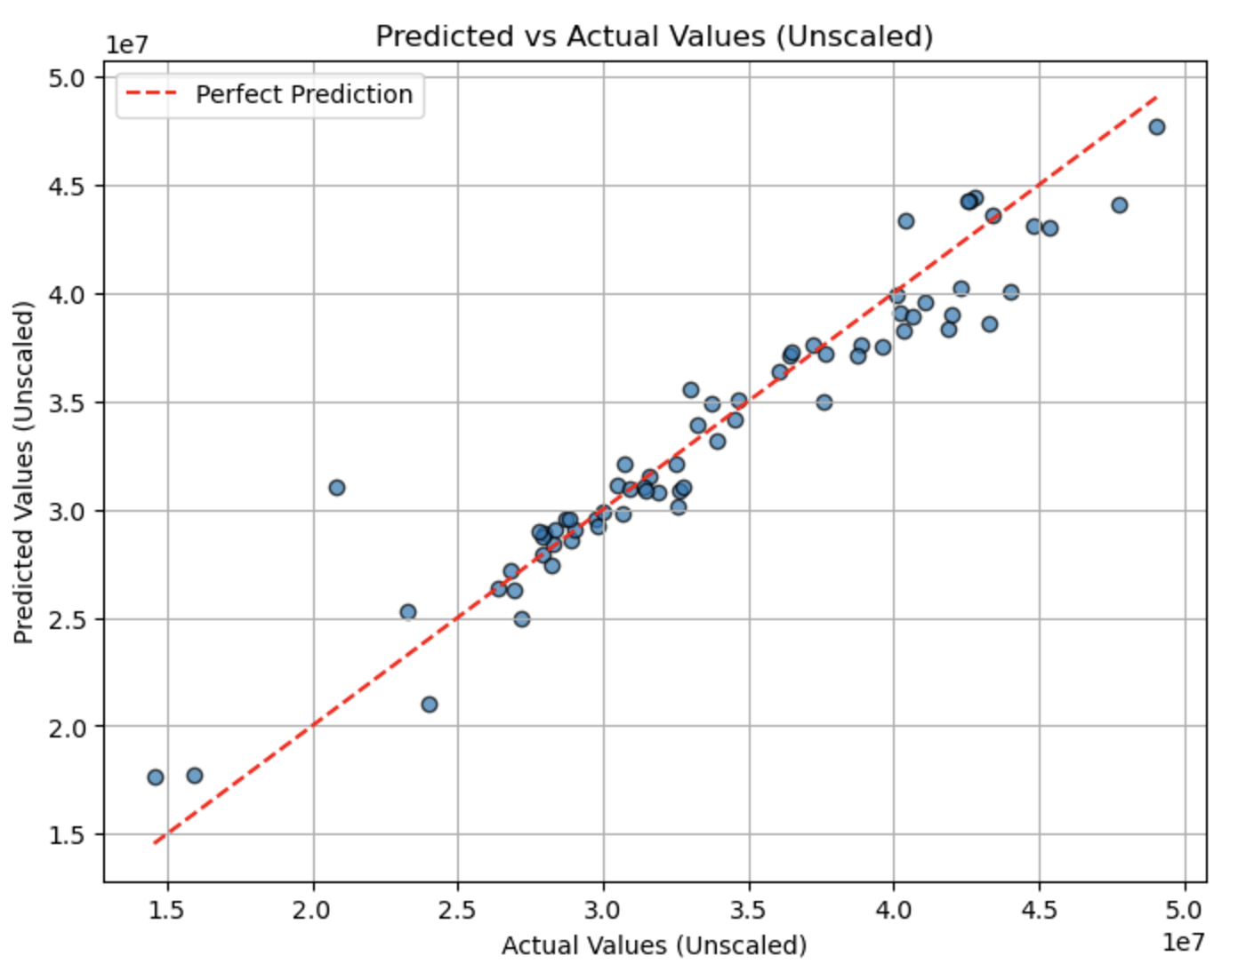
After developing and fitting our model, we achieved an R² score of 91%, indicating strong accuracy.
Graph Details:
The points represent individual test instances of monthly data.
The red line represents a perfect prediction.
Points close to the red line show high model accuracy.
Table Summary: The table compares the actual data to the model's predictions, highlighting the relationship between them.

Slide 15

Thank You
Javier Reyes
Michael Hennessy
Hunter Katigbak
Jeremy Bentley

